Slide 1

ChangeradarAI
AI-powered Change Impact Analysis for Jira User Stories

Slide 2

Creative Coders
Meet the team driving innovation:
Harini
Archana
Pradeep
Karunya
Ajith

Slide 3

The Challenge: Manual Impact Analysis is Slow and Risky
Complex architecture creates hidden dependency chains
Small story changes can trigger cascading effects across downstream APIs, databases, and external integrations that are hard to predict.
Developers spend 1-3 days manually analyzing impact
They must identify affected components, review dependent repositories, and understand downstream API behavior through manual exploration.
QA teams lack clarity on test coverage and risk areas
Without comprehensive impact visibility, testing becomes guesswork, leading to missed edge cases and potential production issues.

Slide 4





Introducing ChangeradarAI
An intelligent impact analysis tool that reads Jira acceptance criteria and automatically predicts technical impact across your entire architecture. It generates structured JSON reports with complete dependency mapping, giving developers and QA teams instant visibility before development even begins.
The tool attaches comprehensive impact reports directly to Jira stories, eliminating manual guesswork and dramatically accelerating grooming discussions.
Impacted systems & modules
Downstream API effects
Dependent repositories
Risk scoring & test cases

Slide 5






Key Capabilities
Jira Story → Impact Mapping
Dependency Graph Reasoning
Automatically detects which microservices, API endpoints, and components will be affected based on the Acceptance Criteria. No manual tracing required.
Understands database dependencies, downstream calls, and external system integrations. Traces cascading impact automatically across your architecture.
Developer Recommendations
QA Test Recommendations
Suggests impacted code areas including files to modify, methods and functions affected, plus potential side effects to watch for.
Generates unit tests, integration test paths, security validation scenarios, and negative test cases for comprehensive coverage.
Risk Scoring Engine
Powered by LLM APIs
Uses weighted analysis of functional complexity, data sensitivity, security impact, and dependency fan-out. Outputs Low/Medium/High/Critical with 0-100 precision scoring.
Uses Groq + Llama 3.3 for sub-second inference with structured JSON output. No GPU required, with smart caching for instant re-execution.

Slide 6





Why ChangeradarAI Transforms Your Workflow
Accelerates Planning
Reduces impact analysis from days to seconds, enabling faster grooming and sprint planning sessions.
Improves Accuracy
Uses architectural reasoning to eliminate manual guesswork and human error in dependency mapping.
Reduces SME Dependency
Democratizes architectural knowledge, so developers don't need to constantly consult senior engineers for impact understanding.
Boosts Quality
Enhances developer productivity and QA readiness with complete visibility into risks and test requirements upfront.

Slide 7
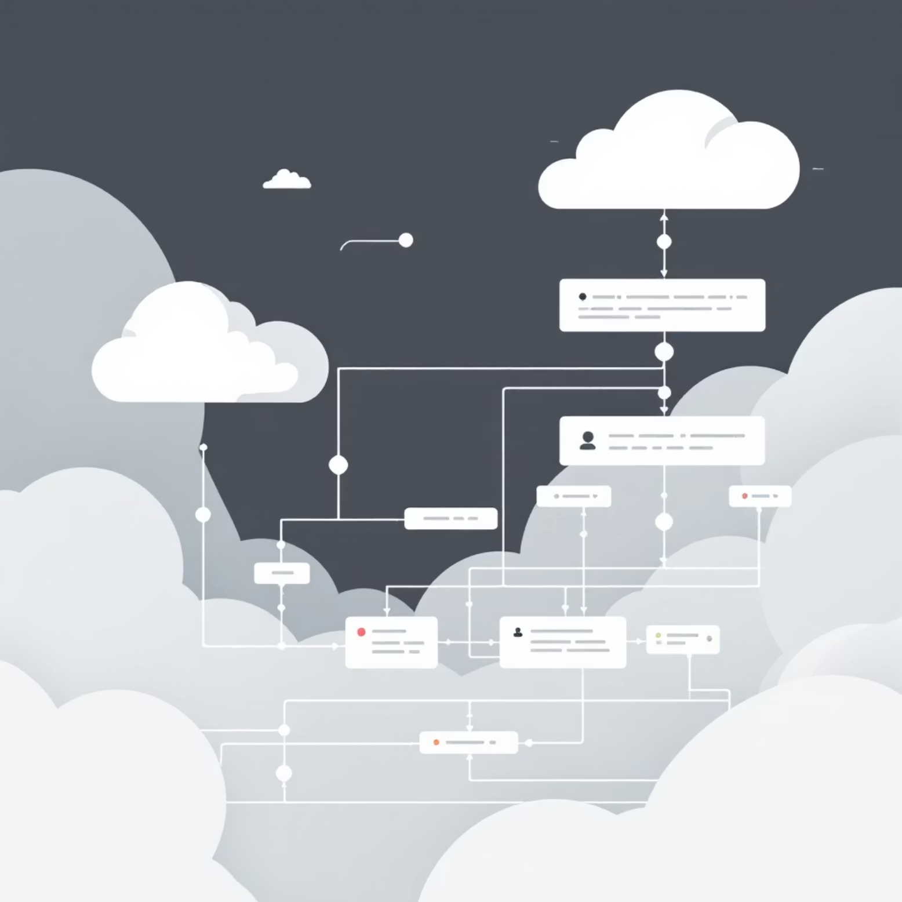
Feature Deep Dive: Impact Mapping
Intelligent Story Analysis
ChangeradarAI reads Jira-style user stories and acceptance criteria, then maps them to affected services with precision. It predicts impacted API endpoints and identifies exactly which code components require updates.
The AI understands technical context, business logic, and architectural patterns to deliver actionable insights that developers can trust.
01
02
Parse acceptance criteria from Jira story
Map requirements to microservices
03
04
Identify affected API endpoints
List required code component changes

Slide 8

Feature Deep Dive: Dependency Graph Reasoning
Understanding the ripple effects of changes across a complex architecture is critical. ChangeradarAI automatically traces downstream service relationships, reads integrations with databases and external APIs, and finds cascading impact without manual exploration.
Service Relationships
Database Dependencies
Maps direct and indirect dependencies between microservices, identifying which services call which APIs.
Tracks schema changes, query impacts, and data flow between services and data stores.
External Integrations
Cascading Effects
Identifies third-party API calls, webhook configurations, and external system touchpoints.
Discovers multi-hop dependencies where changes propagate through multiple service layers.

Slide 9
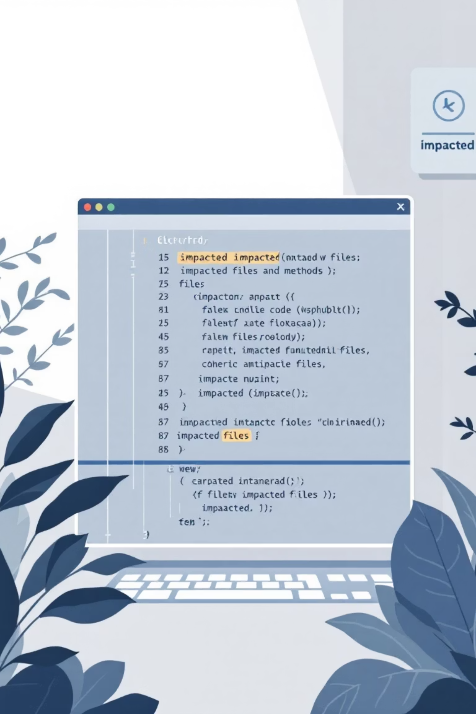
Feature Deep Dive: Developer Recommendations
Files & Methods to Update
Potential Side Effects
Provides specific file paths and method signatures that require modification based on the story requirements.
Highlights unintended consequences like breaking changes, performance impacts, or backward compatibility issues.
Mitigation Steps
Suggests concrete actions to prevent issues: feature flags, gradual rollouts, or compensating transactions.
Instead of developers manually exploring the entire complex architecture, our tool automatically traces dependencies, evaluates API interactions, and generates an accurate impact report in seconds. This dramatically reduces uncertainty and improves delivery quality.

Slide 10

Feature Deep Dive: QA Test Recommendations
Comprehensive Test Coverage
ChangeradarAI generates intelligent test recommendations across multiple layers, ensuring thorough validation before deployment. QA teams receive ready-to-execute test scenarios tailored to the specific impact areas.
Unit Test Recommendations
Integration Path Coverage
Suggests specific unit tests for modified methods and functions, including edge cases and boundary conditions.
Maps integration test scenarios across service boundaries, API contracts, and data flow validations.
Security Validation
Negative Test Cases
Identifies security-sensitive changes requiring authentication, authorization, and data protection testing.
Recommends failure scenarios, error handling paths, and resilience tests to ensure robust implementation.

Slide 11
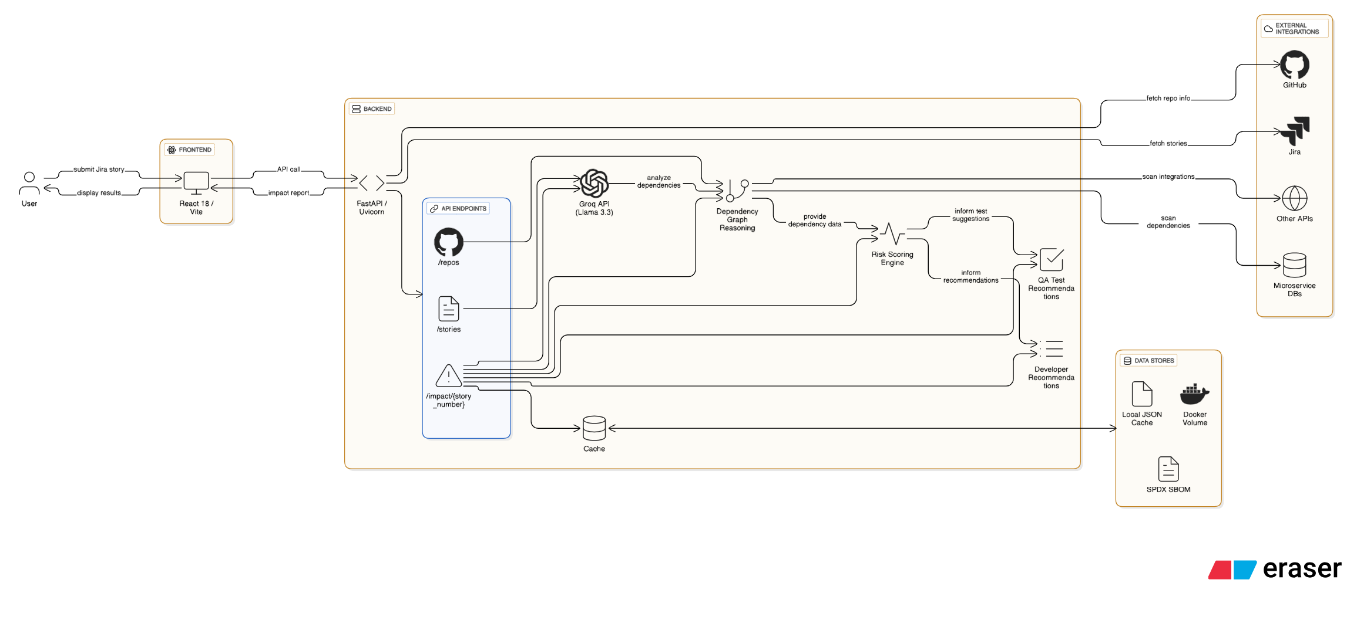
ChangeradarAI System Architecture Overview
This diagram illustrates the comprehensive flow of ChangeradarAI, from initial Jira story input to the final impact analysis displayed on the React dashboard.

Slide 12
System Architecture Deep Dive
Data Flow Process
01
02
Jira Integration Layer
FastAPI Backend Processing
Extracts user stories and acceptance criteria via Jira REST API
Impact Engine: Core analysis module that maps requirements to technical components
Converts story content to structured JSON format
Handles authentication and rate limiting
GitHub Repo Scanner: Analyzes codebase structure and identifies affected files
Supports bulk story processing for sprint analysis
Dependency Graph Builder: Maps service relationships and API connections
Risk Scoring Engine: Calculates weighted risk scores based on complexity factors
JSON Cache Layer: Stores analysis results for instant re-access
03
04
AI Processing with Groq Llama 3.3
React Frontend Dashboard
Sub-second inference with structured JSON output
Story Explorer: Browse and select Jira stories
Processes architectural context and business requirements
Impact Visualization: Interactive dependency graphs
Generates comprehensive impact predictions
Risk Heatmaps: Color-coded risk assessment displays
Returns formatted analysis ready for frontend consumption
Test Recommendations: Organized test case suggestions
Export Capabilities: PDF reports and Jira comment integration

Slide 13

API Endpoints & LLM Advantages
Core API Endpoints
GET /api/stories
POST /api/impact/analyze
Lists all available Jira stories with metadata
Primary endpoint for impact analysis
Supports filtering by sprint, assignee, and status
Accepts story ID or raw acceptance criteria
Returns story summaries for quick selection
Triggers full AI processing pipeline
Returns comprehensive JSON impact report
GET /api/impact/{story_id}
GET /api/repositories
Retrieves cached impact analysis
Lists connected GitHub repositories
Instant response for previously analyzed stories
Shows microservice architecture overview
Includes dependency graphs and risk scores
Provides repository health metrics
POST /api/cache/refresh
Forces cache invalidation and re-analysis
Useful when architecture changes occur
Maintains analysis accuracy over time

Slide 14




⚡ Groq Llama 3.3 LLM Advantages
Ultra-Fast Inference Performance
Advanced Reasoning Capabilities
Sub-second response times for complex architectural analysis
Contextual understanding of microservice architectures and dependencies
Structured JSON output eliminates post-processing overhead
Pattern recognition across similar story types and technical requirements
Batch processing capability for analyzing multiple stories simultaneously
Multi-hop dependency tracing through complex service relationships
Consistent formatting ensures reliable integration with frontend components
Risk assessment logic based on architectural complexity and business impact
Cost-Effective Scaling
Integration Benefits
No GPU infrastructure required - leverages Groq's optimized hardware
RESTful API compatibility with existing development workflows
Smart caching reduces API calls for repeated or similar analyses
JSON schema validation ensures data consistency across the pipeline
Predictable pricing model scales with usage without surprise costs
Real-time processing enables immediate feedback during story grooming
High availability with built-in redundancy and failover capabilities
Extensible prompt engineering allows customization for different architectural patterns

Slide 15




🔧 Technical Implementation Details
Delving deeper into the foundational technologies and methodologies employed across the ChangeradarAI platform.
Frontend Architecture
Backend Infrastructure
React 18 with TypeScript for type-safe component development
FastAPI with async/await for high-performance concurrent request handling
Vite for lightning-fast development builds and hot module replacement
Pydantic models for robust JSON schema validation and serialization
D3.js for interactive dependency graph visualizations
SQLAlchemy with PostgreSQL for persistent caching and audit trails
Material-UI components for consistent design system
Redis for high-speed session caching and rate limiting
React Query for efficient API state management and caching
Uvicorn ASGI server with automatic scaling capabilities
AI Integration Layer
Security & Monitoring
Groq SDK for optimized Llama 3.3 API integration
OAuth 2.0 integration with Jira and GitHub for secure authentication
Custom prompt templates with dynamic context injection
API rate limiting to prevent abuse and ensure fair usage
JSON schema enforcement for consistent LLM output formatting
Structured logging with correlation IDs for distributed tracing
Retry logic with exponential backoff for API resilience
Health check endpoints for container orchestration monitoring
Token usage optimization through intelligent prompt compression
Error tracking with detailed stack traces and user context

